Slide 1


Everway SDET
Shift-Left Program
August / September 2026

Slide 2

Meet your instructor
Ray Coulstock​
Senior Technical Trainer

Slide 3

Session timings
Start and finish
12:30 – 17:00
Breaks
14:00 – 14:10
15.50 – 16:00

Slide 4

Housekeeping
Feel free to interrupt
the trainer at any
time - you don’t
need to
raise your
hand!
Keep your
camera on
Stay muted
but be ready
to regularly un-
mute and join in
Turn phones to silent, and close your email

Slide 5


Shift-Left Program
What we are going to cover in this program.
Phase 1 – Think like an SDET
Shift-left, quality ownership, Testing Pyramid, Playwright foundations.
API testing with Postman, AI-enabled testing, assessment.
Phase 2 – Engineer a quality solution
Playwright suites, AI in practice, Pact, JMeter.
Build a broader automated testing strategy rather than simply automate UI tests.
Developer coaching, testability, exploratory testing.
Operate as an embedded SDET who improves the team’s engineering practices.
Phase 3 - Hackathon
Coming Soon.

Slide 6
Phase 1 Day 1
Shift-Left Thinking: Quality Across the SDLC
The Testing Pyramid in Practice
Playwright Foundations (TypeScript, CI/CD integration) — pre-requisite for Phase 2

Slide 7
From QA Engineer to SDET
Today's question: How do we build confidence into a feature?
How do we build confidence/test now ?
How CAN we build confidence/test in the future ?

Slide 8

Demo: Neueda VM
Let’s investigate the Neueda VM and the training project we are working with.
Find the github repo
Working with codespaces.

Slide 9
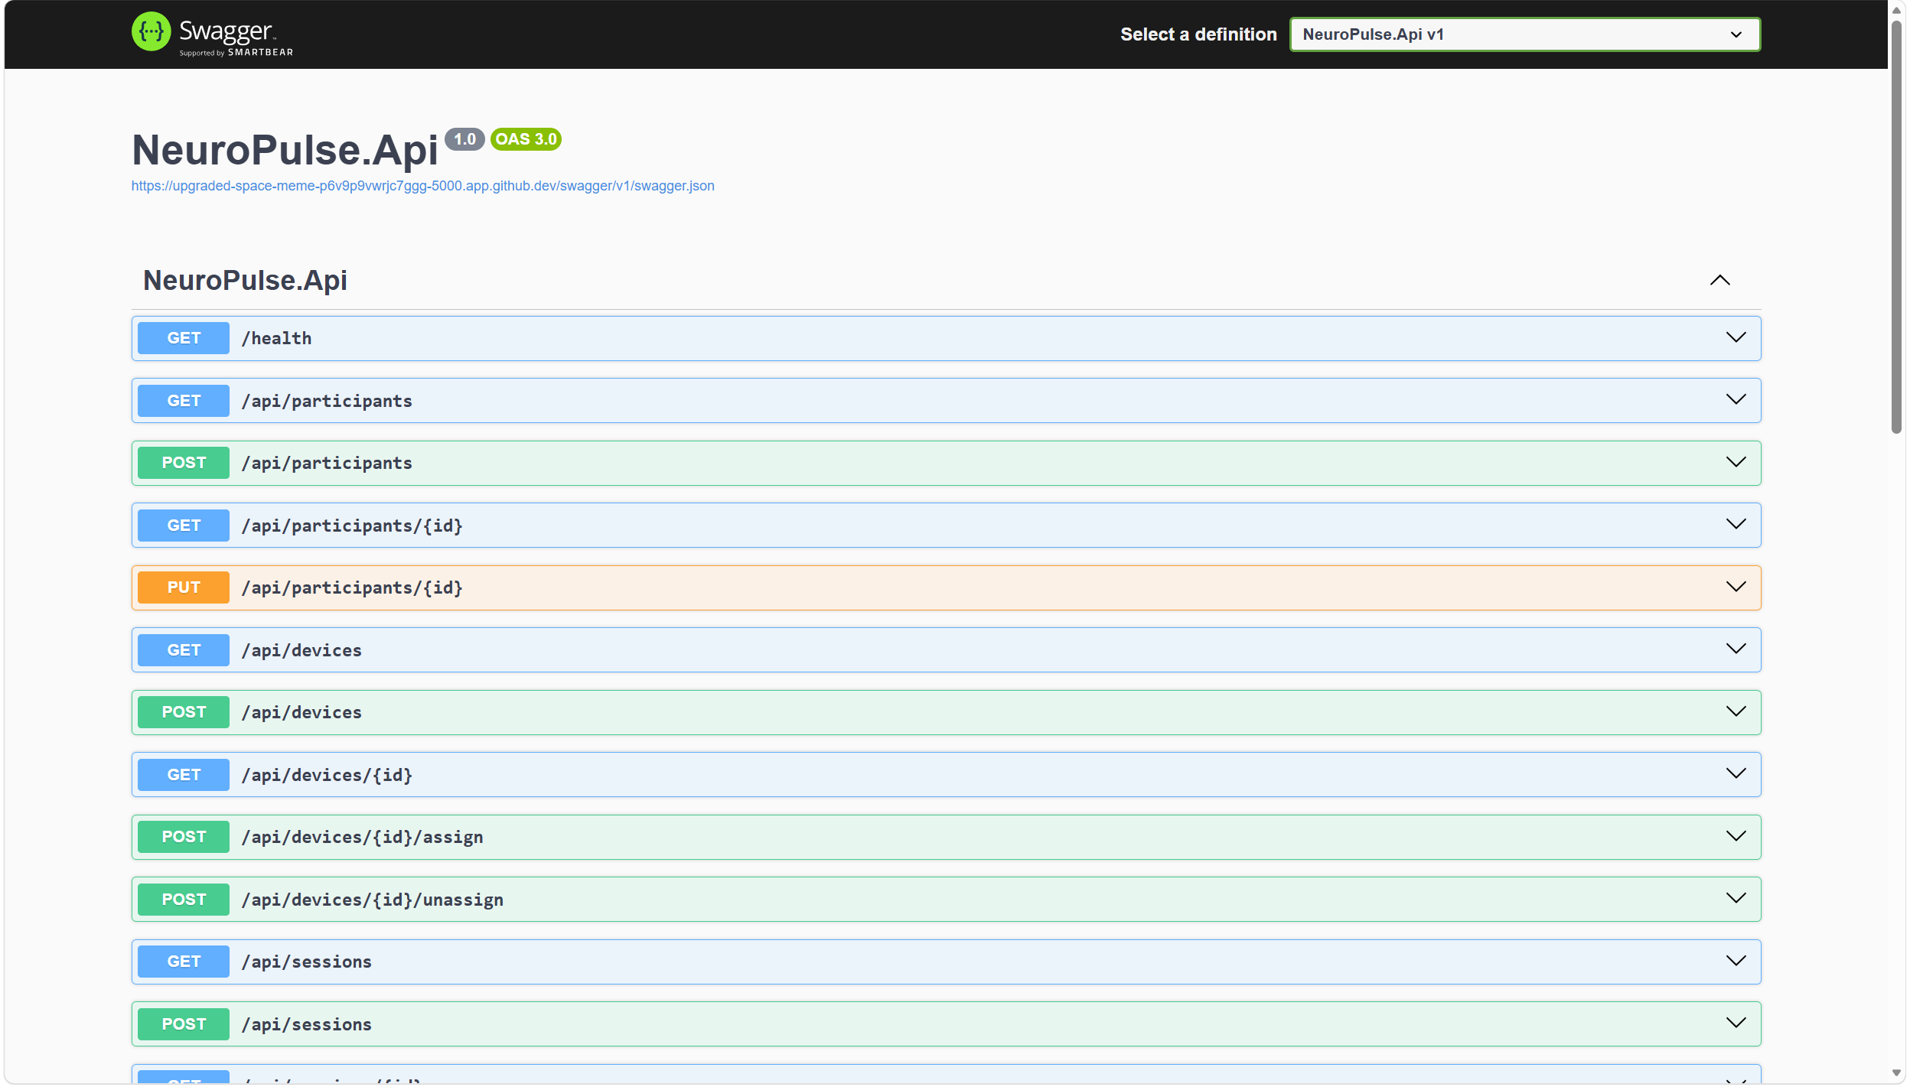
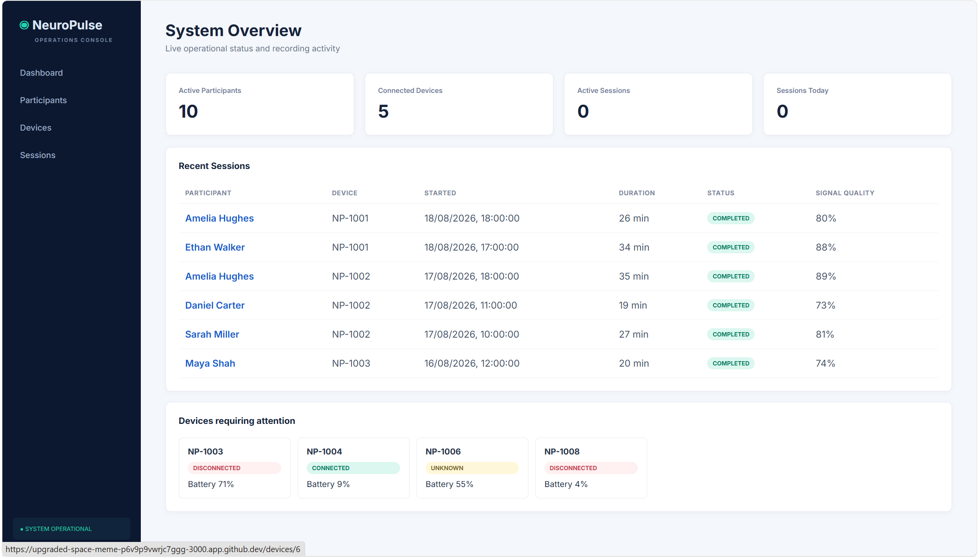
Our Training App - NeuroPulse
NeuroPulse API
NeuroPulse React UI
Device Simulator

Slide 10
Where Are We Going?
QA Engineer Did it work?
↓
Automation Engineer Can we check it repeatedly?
↓
SDET How should we build confidence?
↓
Quality Advocate How can the team prevent the risk?
Not: “a tester who writes automation”

Slide 11
Today's Outcomes
By the end, you can:
identify quality interventions across the SDLC;
choose an appropriate test level;
write a small Playwright test with an intent-focused locator;
explain auto-waiting and test independence;
use failure evidence to begin a diagnosis.

Slide 12
The Role Is Changing
Detection | Prevention
Test after implementation | Shape acceptance examples early
Report a defect | Expose an ambiguous rule
Add another UI check | Choose the cheapest useful signal
Own “the testing” | Grow team quality capability
Shift-left means earlier feedback—not moving every test earlier.

Slide 13
Shift-Left Thinking: Quality Across the SDLC

Slide 14

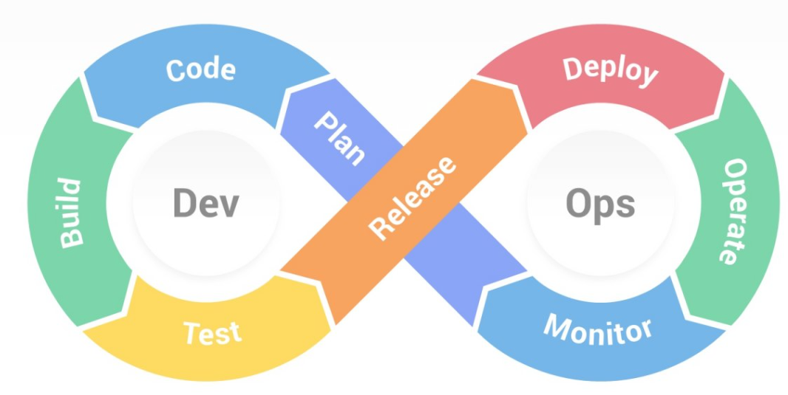
Quality Across the SDLC
Where could quality questions go?
Where could an SDET change the outcome—not just inspect it?

Slide 15

Activity 1 — Quality Across the SDLC
Purpose
Identify where an SDET can prevent, detect, and diagnose risk.
NeuroPulse context
Trace a proposed change to Start Recording from idea through production.
Estimated time: 20 minutes

Slide 16
Activity Debrief — Who Owns Quality?
Where was prevention possible ?
Which feedback could arrive fastest ?
Where did specialist testing expertise add value ?
What still needs observation after release ?

Slide 17
The Testing Pyramid in Practice

Slide 18
The Testing Pyramid Is a Conversation
UI
API
Integration
Unit Tests
Fewer, slower and broad confidence
Many, fast and isolated
Optimise the feedback portfolio, not the shape.

Slide 19
Where Could “Start Recording” Live?
Question | Candidate signal
Battery 9% is rejected | service/unit or API
Simulator V1 shape is understood | contract
Session persists correctly | integration/API
Technician completes the journey | focused UI
One behaviour may justify more than one signal—for different risks.

Slide 20
Activity 2 — Where Should This Test Live?
Purpose
Classify risks by the most useful testing level and defend the trade-off.
NeuroPulse context
Participants, device assignment, recording rules, telemetry, and simulator status.
Estimated time: 20 minutes

Slide 21
Debrief — A Placement Checklist
What risk are we addressing ?
What is the lowest level that can expose it faithfully ?
How fast and diagnostic is the feedback ?
What wiring remains untested ?
Is the maintenance cost proportionate ?

Slide 22


Time to refill
(Tea break)

Slide 23
Playwright Foundations (TypeScript, CI/CD integration)

Slide 24
Typescript and Playwright
Links to cheatsheets

Slide 25
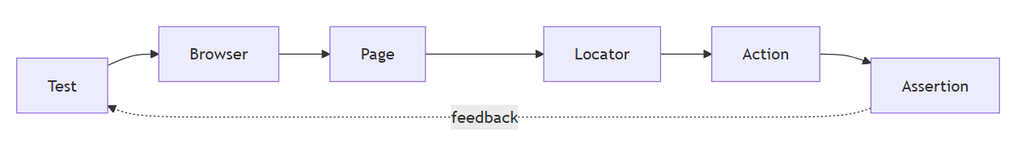
Playwright: A Mental Model
Locate intent → interact like a user → observe behaviour

Slide 26
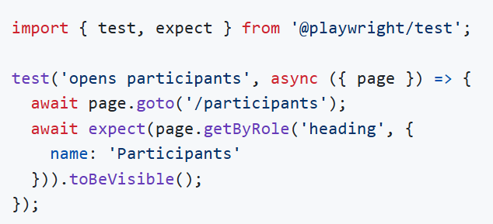
A First NeuroPulse Test
Arrange → Act → Assert (even when the lines overlap)

Slide 27
Activity 3 — Your First NeuroPulse Test
Purpose
Create one readable browser test around an observable user outcome.
NeuroPulse context
Use a Participants, Devices, or Sessions page from the React application.
Estimated time: 25 minutes

Slide 28
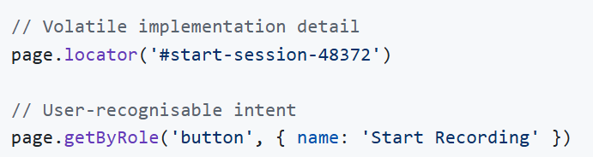
What Makes a Locator Resilient?
Preference guide: role/label → text → test ID → CSS when justified

Slide 29
Accessibility and Testability Reinforce Each Other
A real <button> has role, keyboard behaviour, and focus semantics.
A labelled input is usable by people and automation.
Intent-focused locators survive layout and styling changes.
A failing semantic locator may reveal a product concern.
Would you change the test—or improve the interface?

Slide 30
Activity 4 — Find the Most Resilient Locator
Purpose
Compare selector choices and identify product testability signals.
NeuroPulse context
Search Participants, filter Devices, and inspect the Start Recording control.
Estimated time: 15 minutes

Slide 31
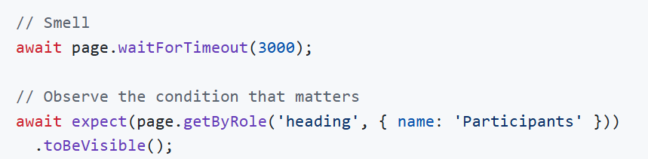
Waiting in an Asynchronous UI
Action requested
↓ Playwright checks actionable state
Click / fill / navigate
↓ application fetches / renders
Web-first assertion retries until timeout

Slide 32
Activity 5 — Why Is This Test Flaky?
Purpose
Replace timing guesses with observation of a meaningful condition.
NeuroPulse context
Investigate navigation or session status while simulator latency changes.
Estimated time: 15 minutes

Slide 33
Test Independence Is Designed
Independent tests:
establish or request known state;
do not rely on execution order;
own unique or resettable data;
clean up only what they own;
can run alone and in parallel.
A retry can hide shared-state coupling.

Slide 34
Time to refill
(Tea break)

Slide 35
Debug the System, Not Just the Line
Evidence | Useful question
Assertion message | What differed?
Screenshot | What was visible?
Trace | What actions, DOM, and network preceded it?
HTML report | Is failure isolated or patterned?
API/service logs | Did the dependency fail?
Failure location ≠ root cause

Slide 36
Activity 6 — Investigate a Failed Test
Purpose
Build a causal hypothesis from Playwright evidence rather than guessing.
NeuroPulse context
Use a recording or navigation failure with report, screenshot, and trace evidence.
Estimated time: 10 minutes

Slide 37

End of Day 1 — Good SDET Questions
What behaviour matters ?
Where should it be tested ?
How quickly can the test give feedback ?
Will the test remain reliable ?
What evidence will help us diagnose failure ?

Slide 38
Thank you

Slide 39
Phase 1 Day 2
API Testing Essentials (Postman)
Introduction to AI-Enabled Testing
Phase 1 Assessment

Slide 40
Phase 2 Day 3
Build Automation Suites in Playwright (Page Object Model, component testing)
AI in Practice
Contract Testing with PACT
Load Testing with JMeter

Slide 41
Phase 2 Day 4
Developer Coaching in Practice
Designing for Testability
Exploratory Testing as a Craft
Phase 2 Assessment

Slide 42
Thank you

